Slide 1


AnyFitting
A Fancy Virtual Try-on Application
Read more

Slide 2


Outline
Background and Motivation
1
Function
Description
2
A Fancy
Live Demo
3
System
Implementation
4
Further
Discussion
5

Slide 3

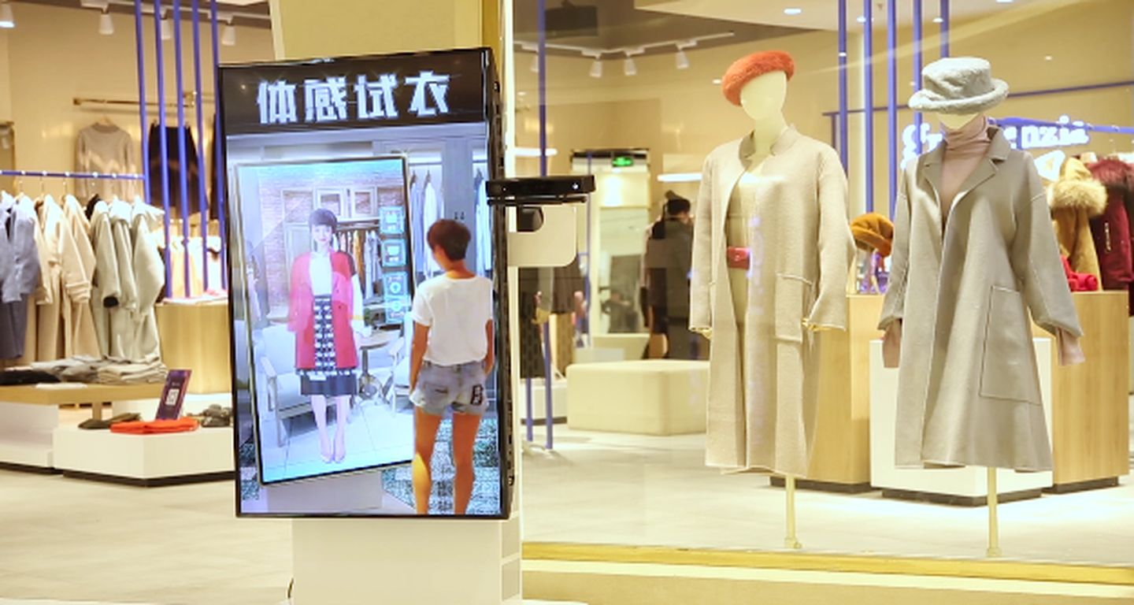
1
Background and Motivation

Slide 4



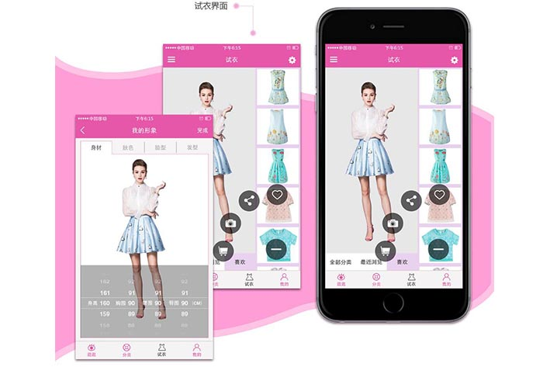

s
Can we design a real person model case by case?
Still exists a lot of problems!!
Can we design a function which allows DIY-uploading clothes by users?
How to find a good way to bridge the gap between virtual try-on and commercial opportunities?
AnyFitting

Slide 5
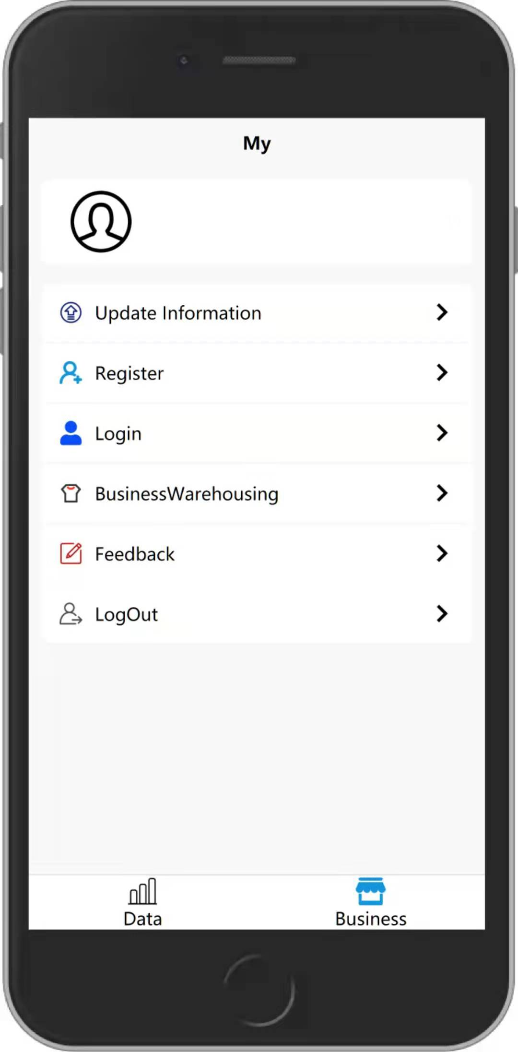
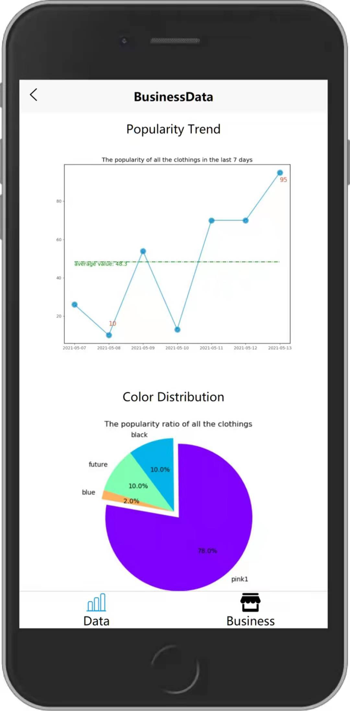
2
Function
Description
AnyFitting

Slide 6



Personal User
Upload Figure and Clothes
50%
Try-on Specific Clothes
Like or Dislike a Try-on
View Try-on History

Slide 7
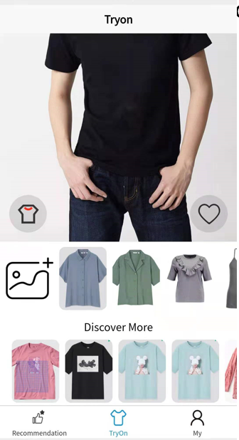
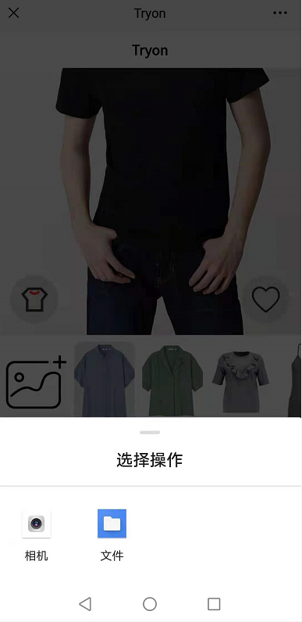
、
Upload Figure and Clothes

Slide 8
Personal User
Upload Figure and Clothes
50%
Try-on Specific Clothes
Like or Dislike a Try-on
View Try-on History

Slide 9

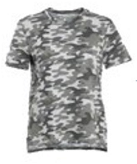
Try-on Specific Clothes

Slide 10
Personal User
Upload Figure and Clothes
50%
Try-on Specific Clothes
Like or Dislike a Try-on
View Try-on History

Slide 11
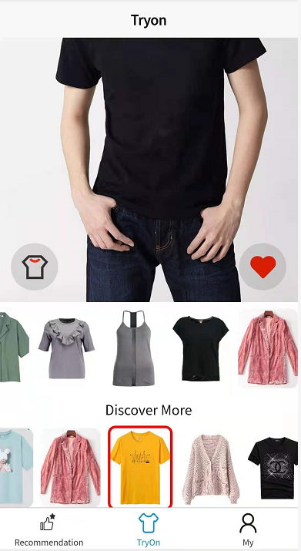
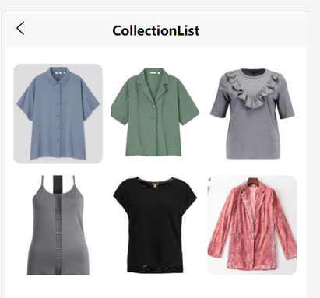
Like or Dislike a Try-on

Slide 12
Personal User
Upload Figure and Clothes
50%
Try-on Specific Clothes
Like or Dislike a Try-on
View Try-on History

Slide 13
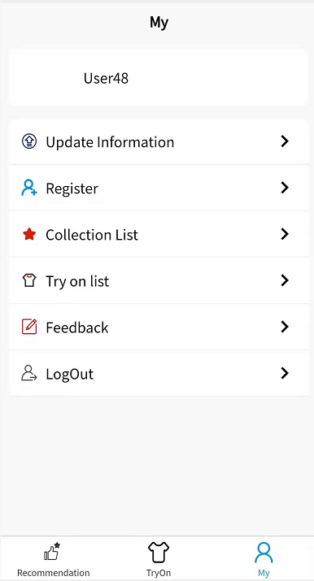
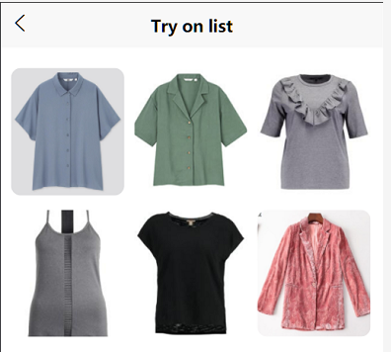
View Try-on History

Slide 14

Business User
Upload Clothes in Batch
Make Daily Personalized
Recommendation to Users
( A mini recom system)
Business Data Analysis and Visualization

Slide 15
Business User
Upload Clothes in Batch
Make Daily Personalized
Recommendation to Users
(A mini recom system)
Business Data Analysis and Visualization

Slide 16
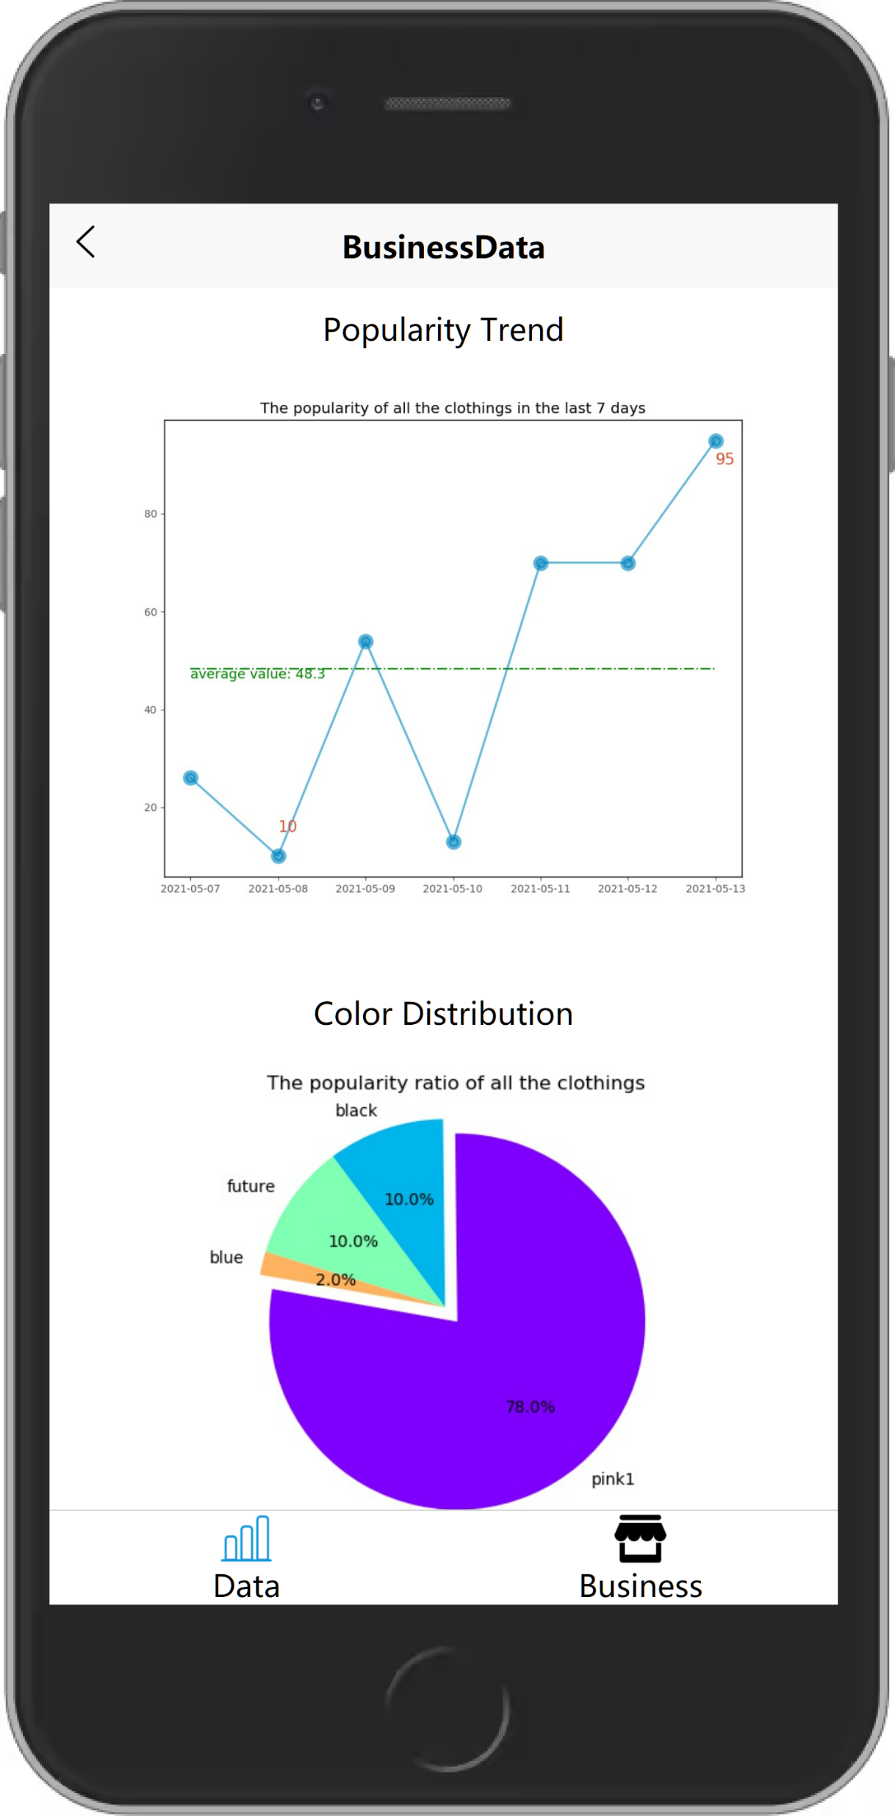
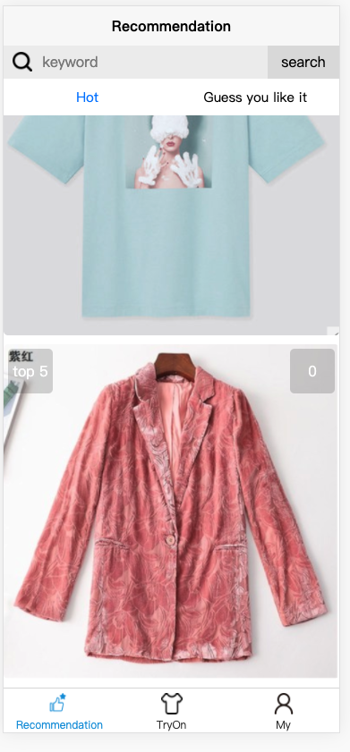
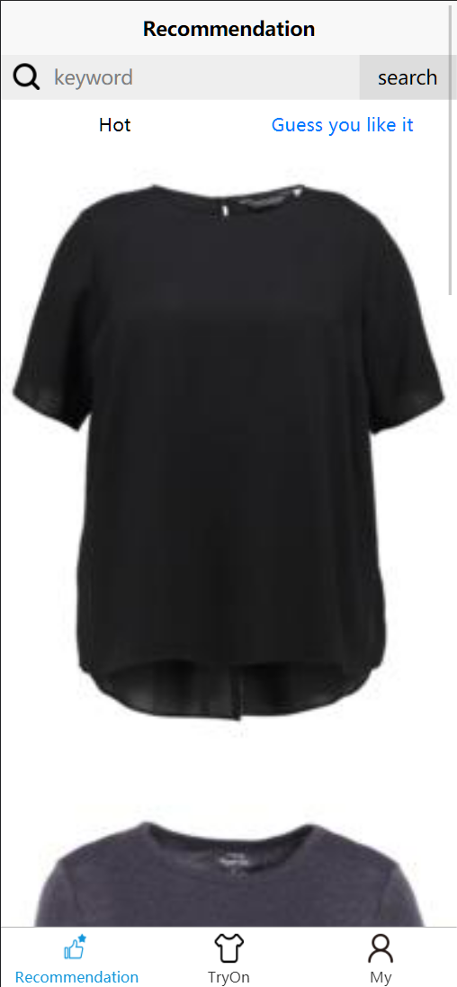

Slide 17
Business User
Upload Clothes in Batch
Make Daily Personalized
Recommendation to Users
(A mini recom system)
Business Data Analysis and Visualization

Slide 18
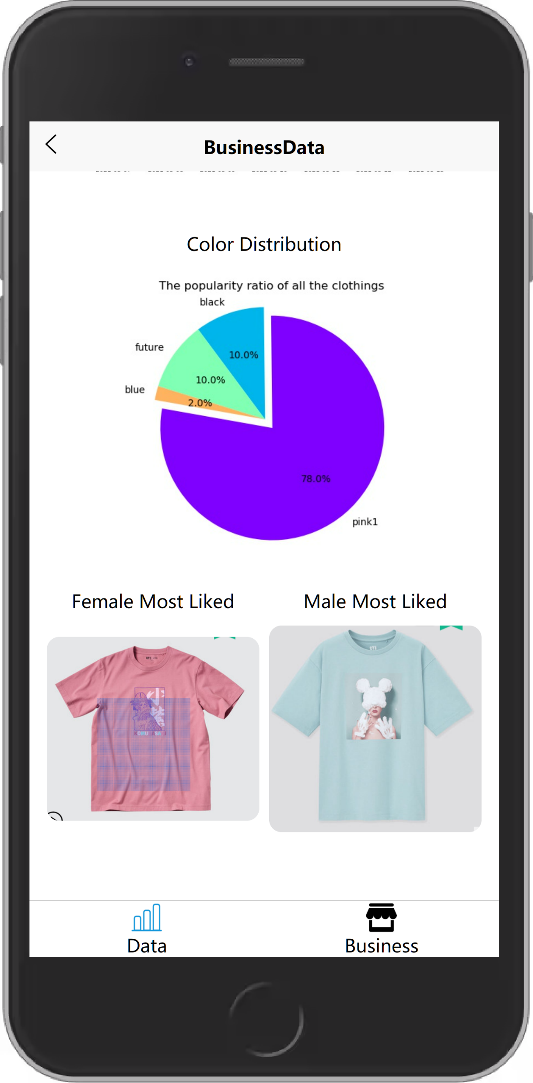

Slide 19
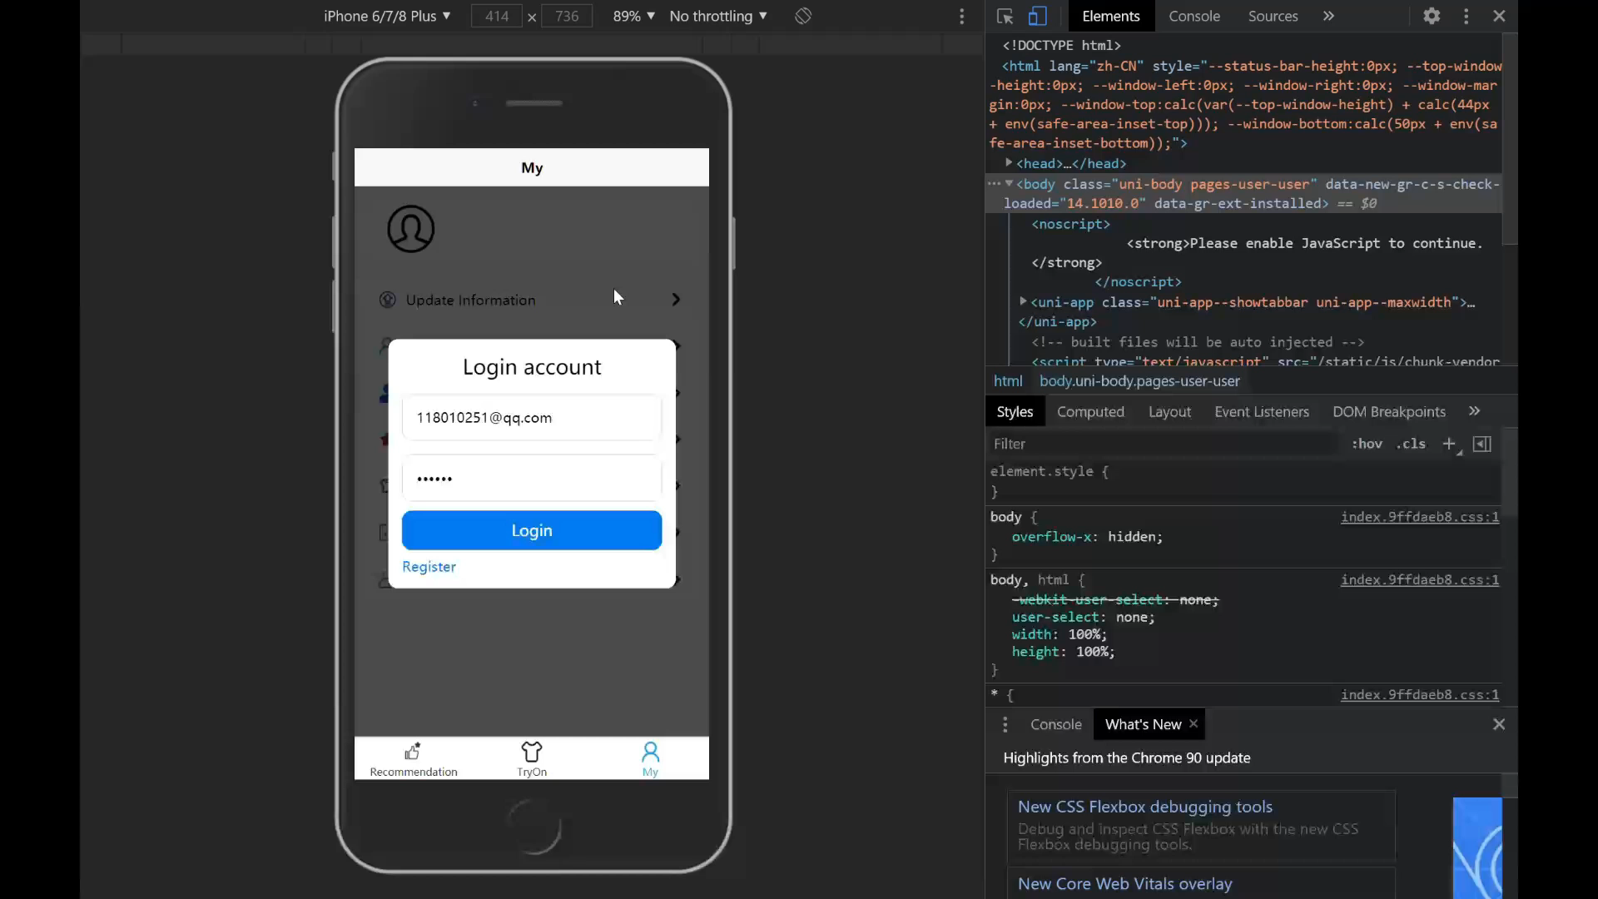
3
uni-app is a framework that uses Vue.js to develop all front-end applications, which makes it possible to quickly render data to the page.
Demo

Slide 20
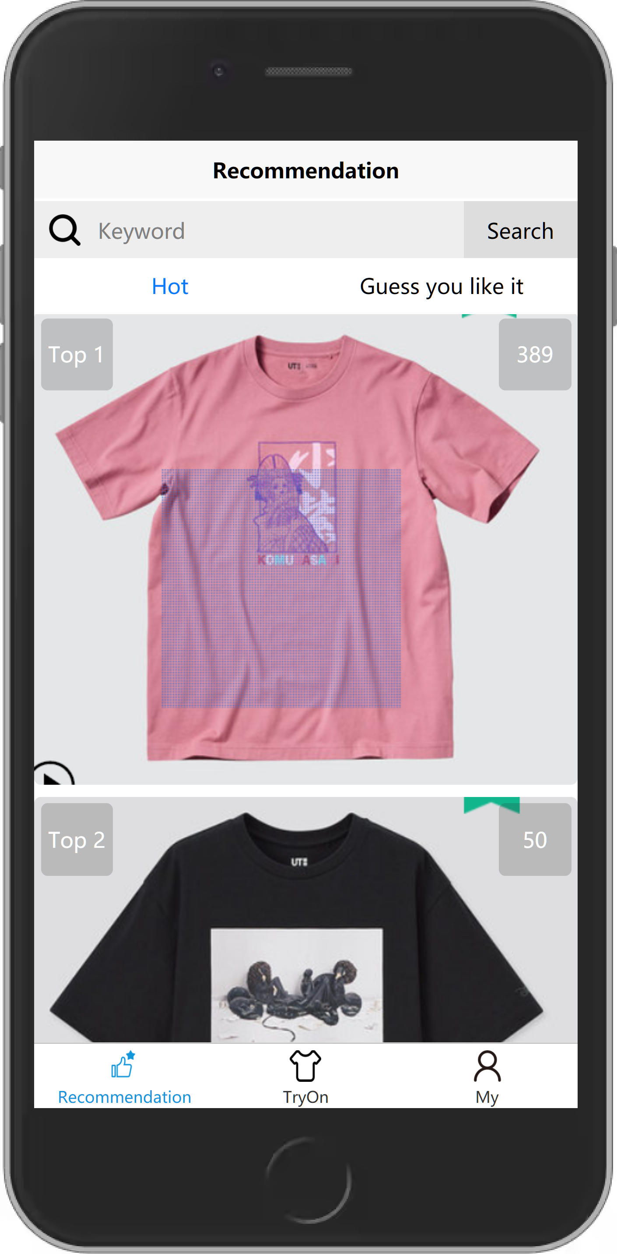
4.1
Front-End
Implementation

Slide 21
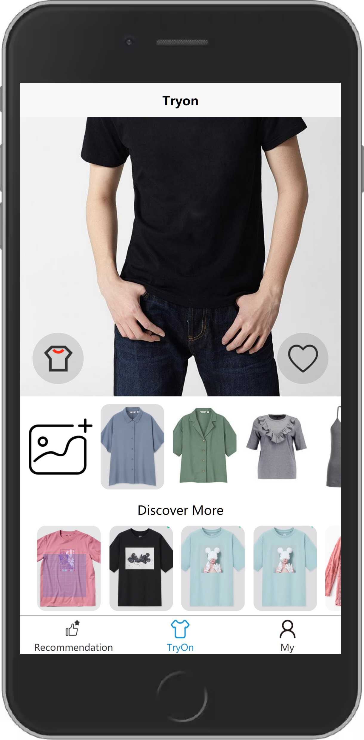
Virtual Try On
Try any clothes you want!
Convenient and safe~
Customized Recommendation
Not only what they like
But what you might like
Maximize Functionality
Connect B & C!
Notes:
uni-app 是一个使用 Vue.js 开发所有前端应用的框架，使得可以使用到Vue的一些非常好用的特性，可以快速将数据渲染到页面上，并且数据更新之后也可以自动渲染，使开发更快速，加上uniapp所提供的一些API，比如网络请求，显示弹窗提醒都更佳方便

Slide 22
Virtual Try On
Try any clothes you want!
Convenient and safe~
Customized Recommendation
Not only what they like
But what you might like
Maximize Functionality
Connect B & C!
Notes:
uni-app 是一个使用 Vue.js 开发所有前端应用的框架，使得可以使用到Vue的一些非常好用的特性，可以快速将数据渲染到页面上，并且数据更新之后也可以自动渲染，使开发更快速，加上uniapp所提供的一些API，比如网络请求，显示弹窗提醒都更佳方便

Slide 23
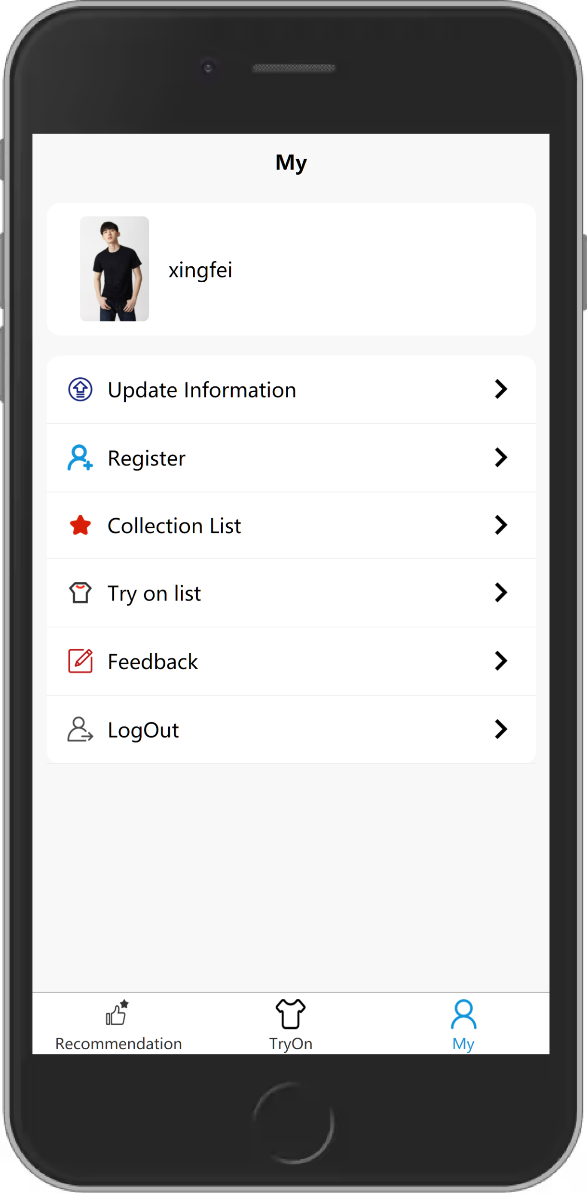
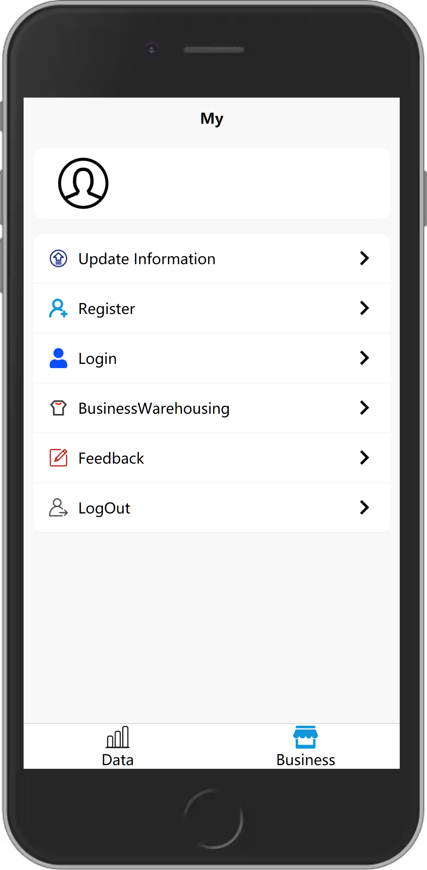
Virtual Try On
Try any clothes you want!
Convenient and safe~
Customized Recommendation
Not only what they like
But what you might like
Maximize Functionality
Connect B & C!
Notes:
uni-app 是一个使用 Vue.js 开发所有前端应用的框架，使得可以使用到Vue的一些非常好用的特性，可以快速将数据渲染到页面上，并且数据更新之后也可以自动渲染，使开发更快速，加上uniapp所提供的一些API，比如网络请求，显示弹窗提醒都更佳方便

Slide 24

Database Design
Add corresponding tags for the input clothes data to reduce workload of categorizing.
Data Visualization
Help business users to operation management,
product planning, and innovation design.
Access to Customers
Provide try-on options for users
Information Security
Make tools more intelligent and safer.

Slide 25
4.2
Back-End & Testing

Slide 26




Slide 27

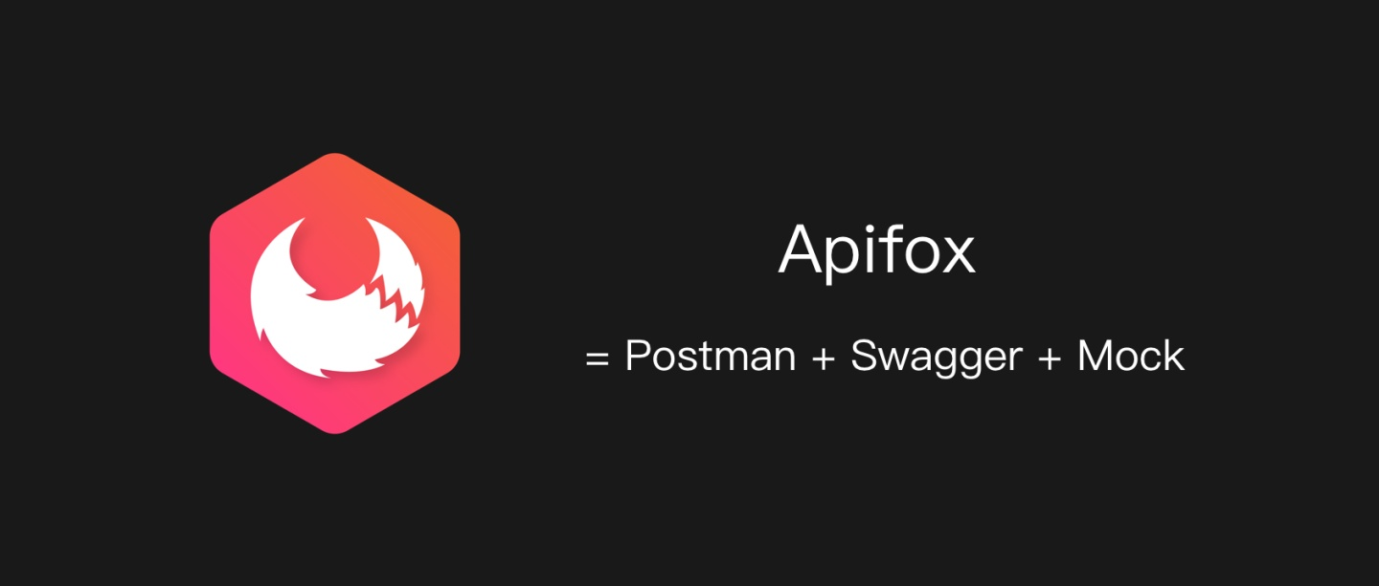
Version Control System
+
Interface Management System

Slide 28
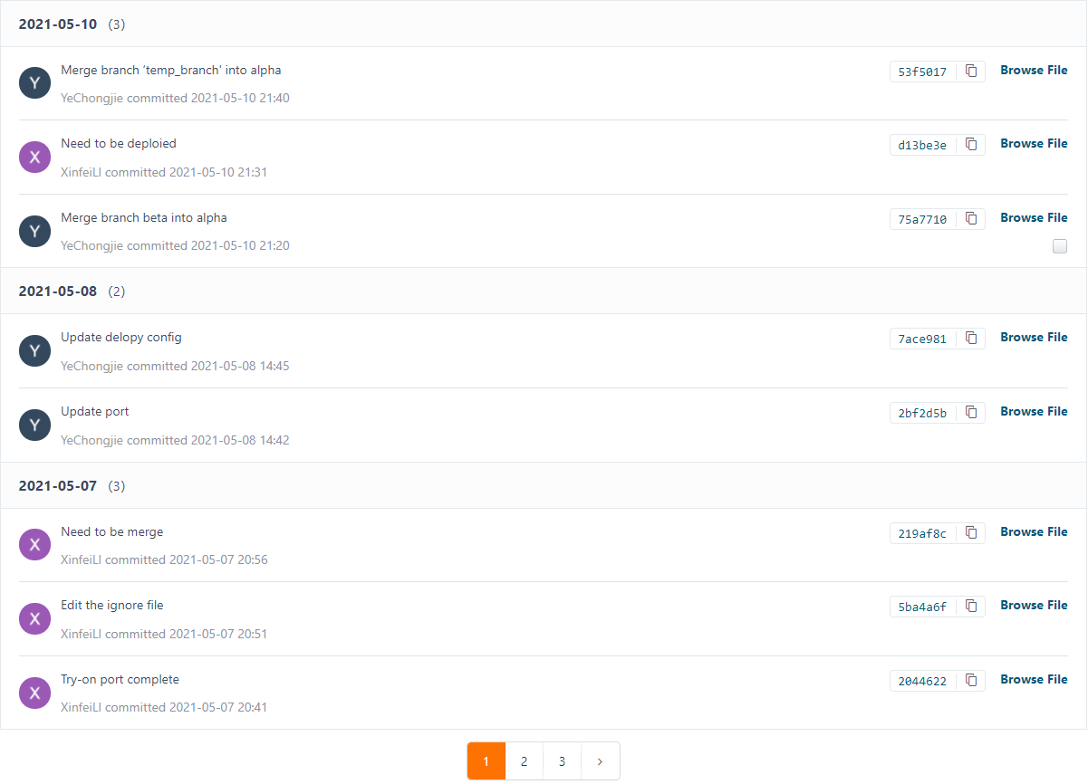
A Few
Commits

Slide 29
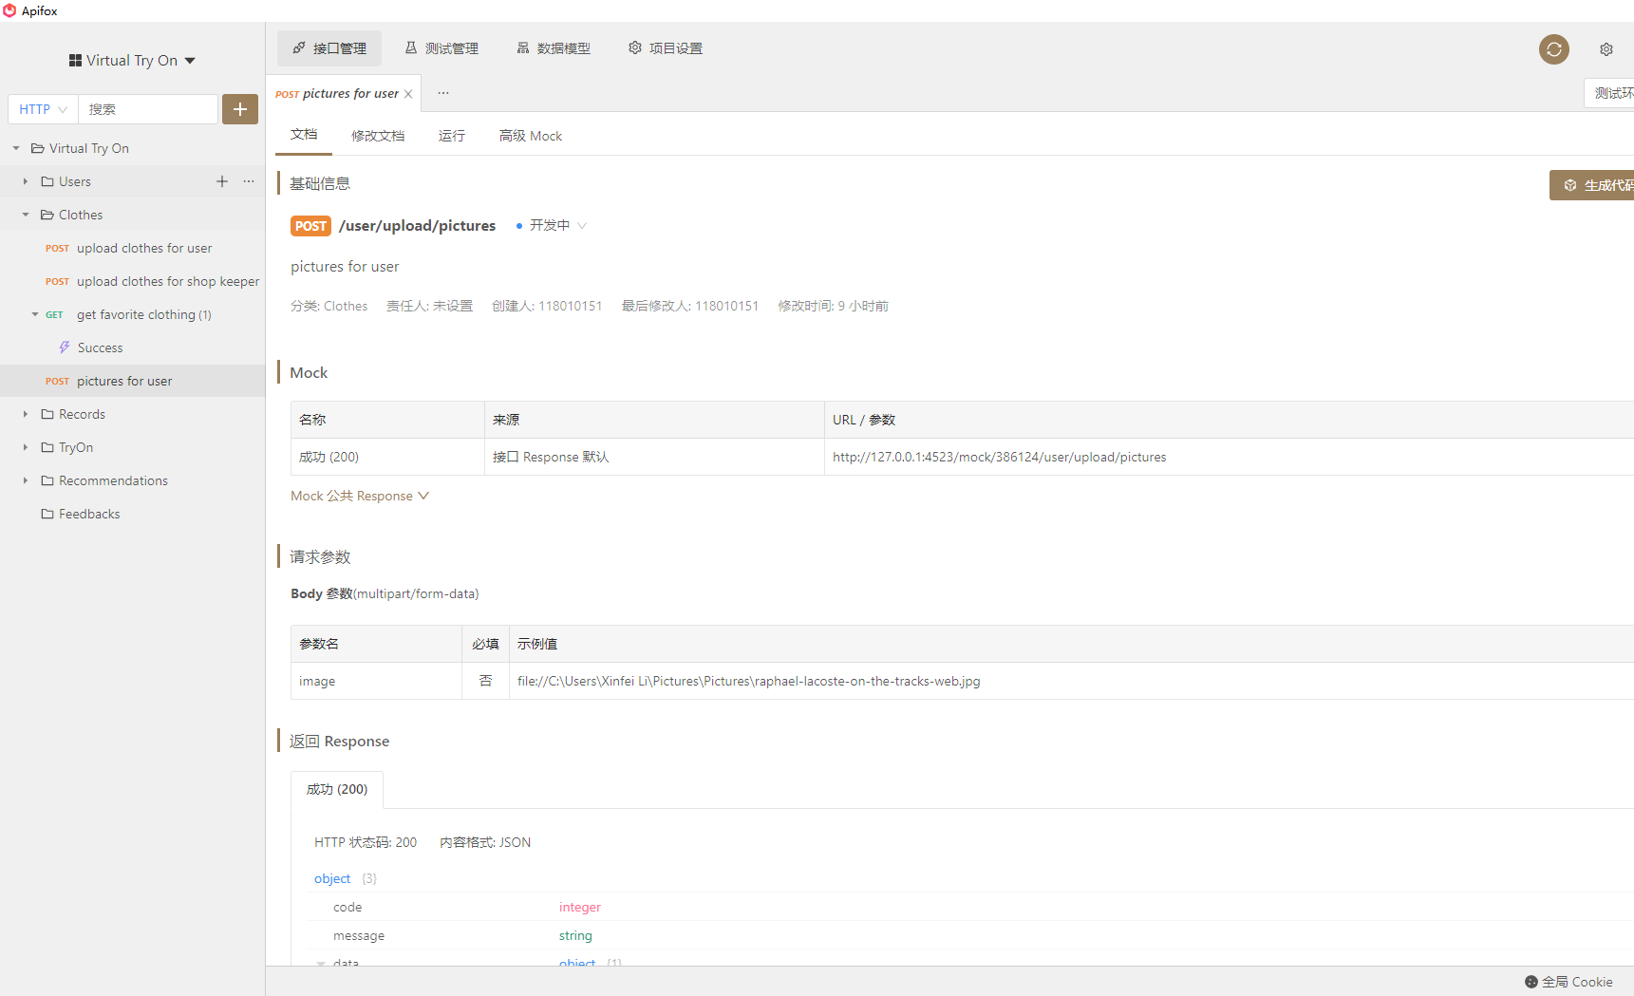
Interface
Example

Slide 30
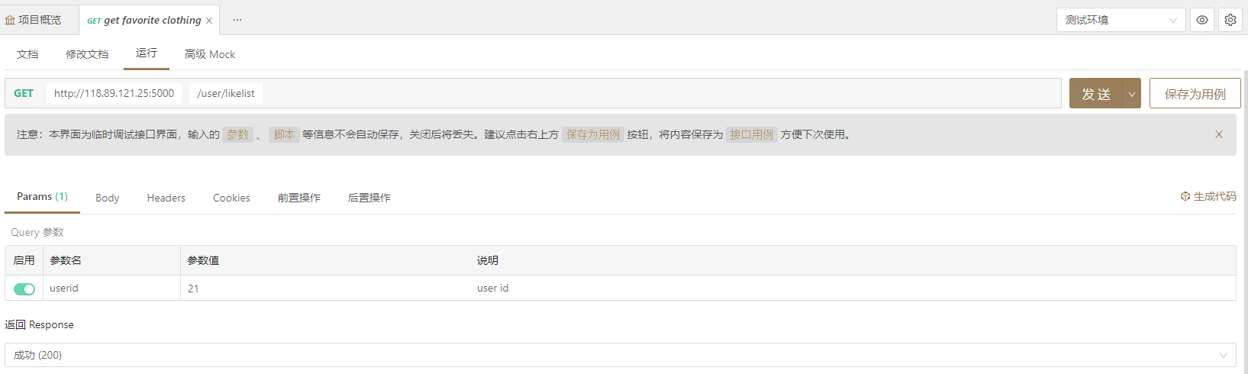
Test Example

Slide 31
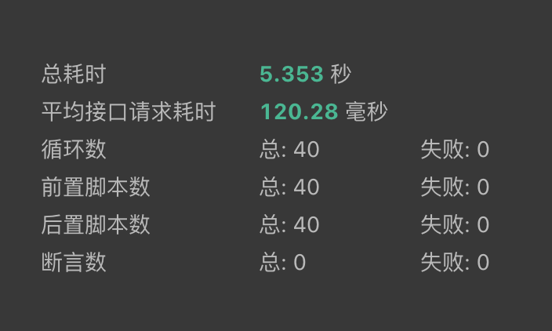
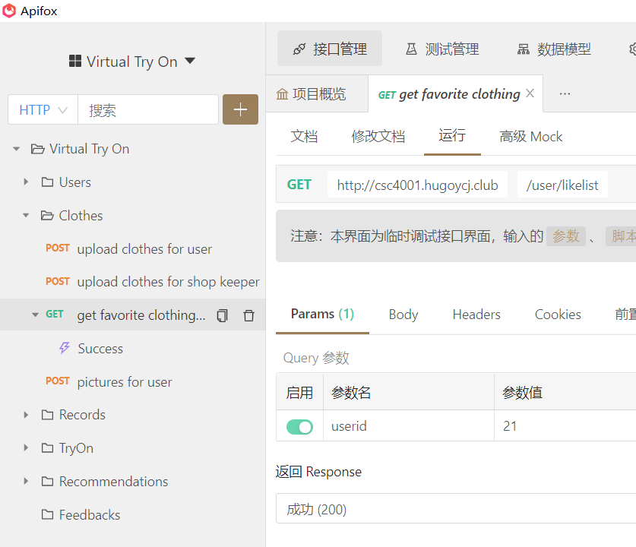
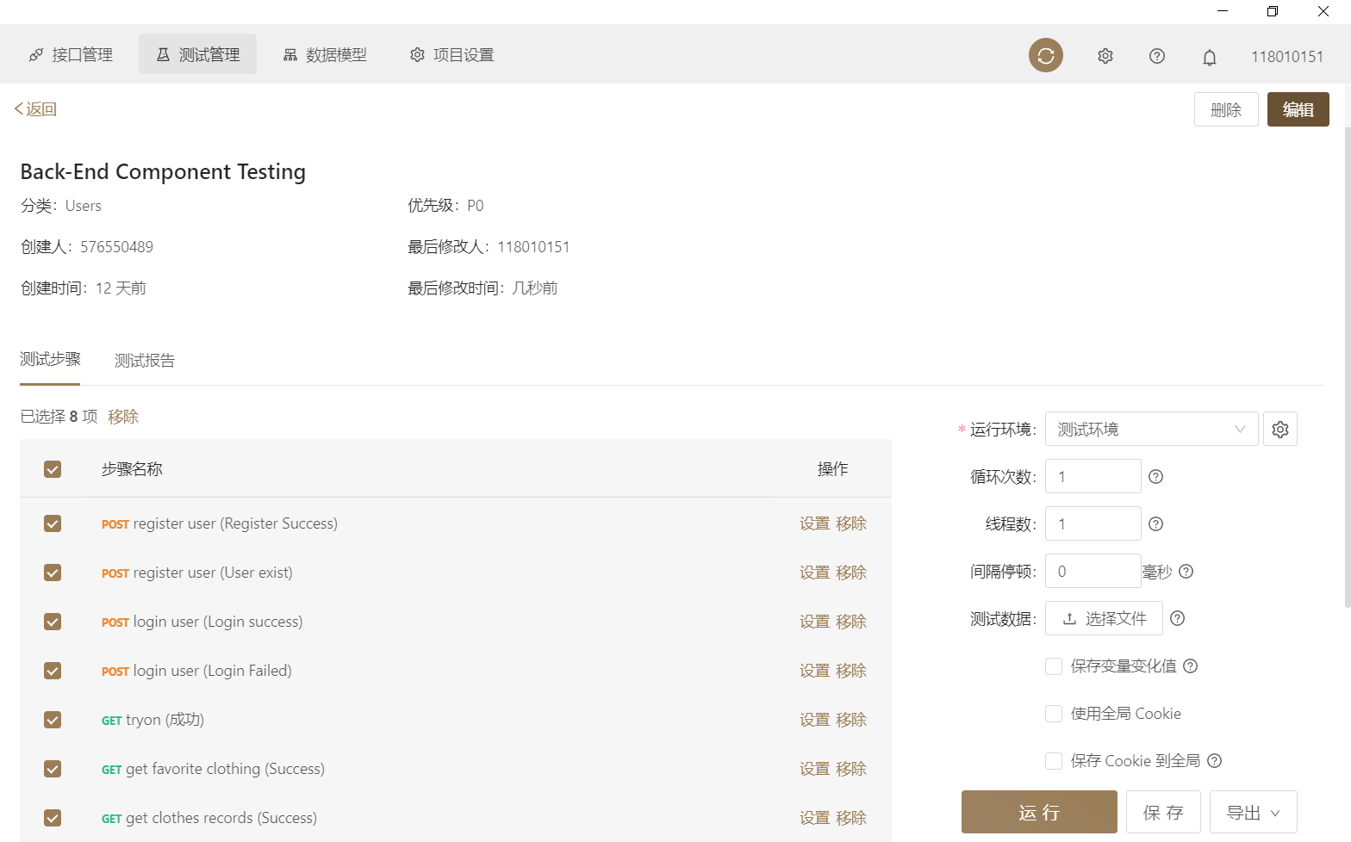
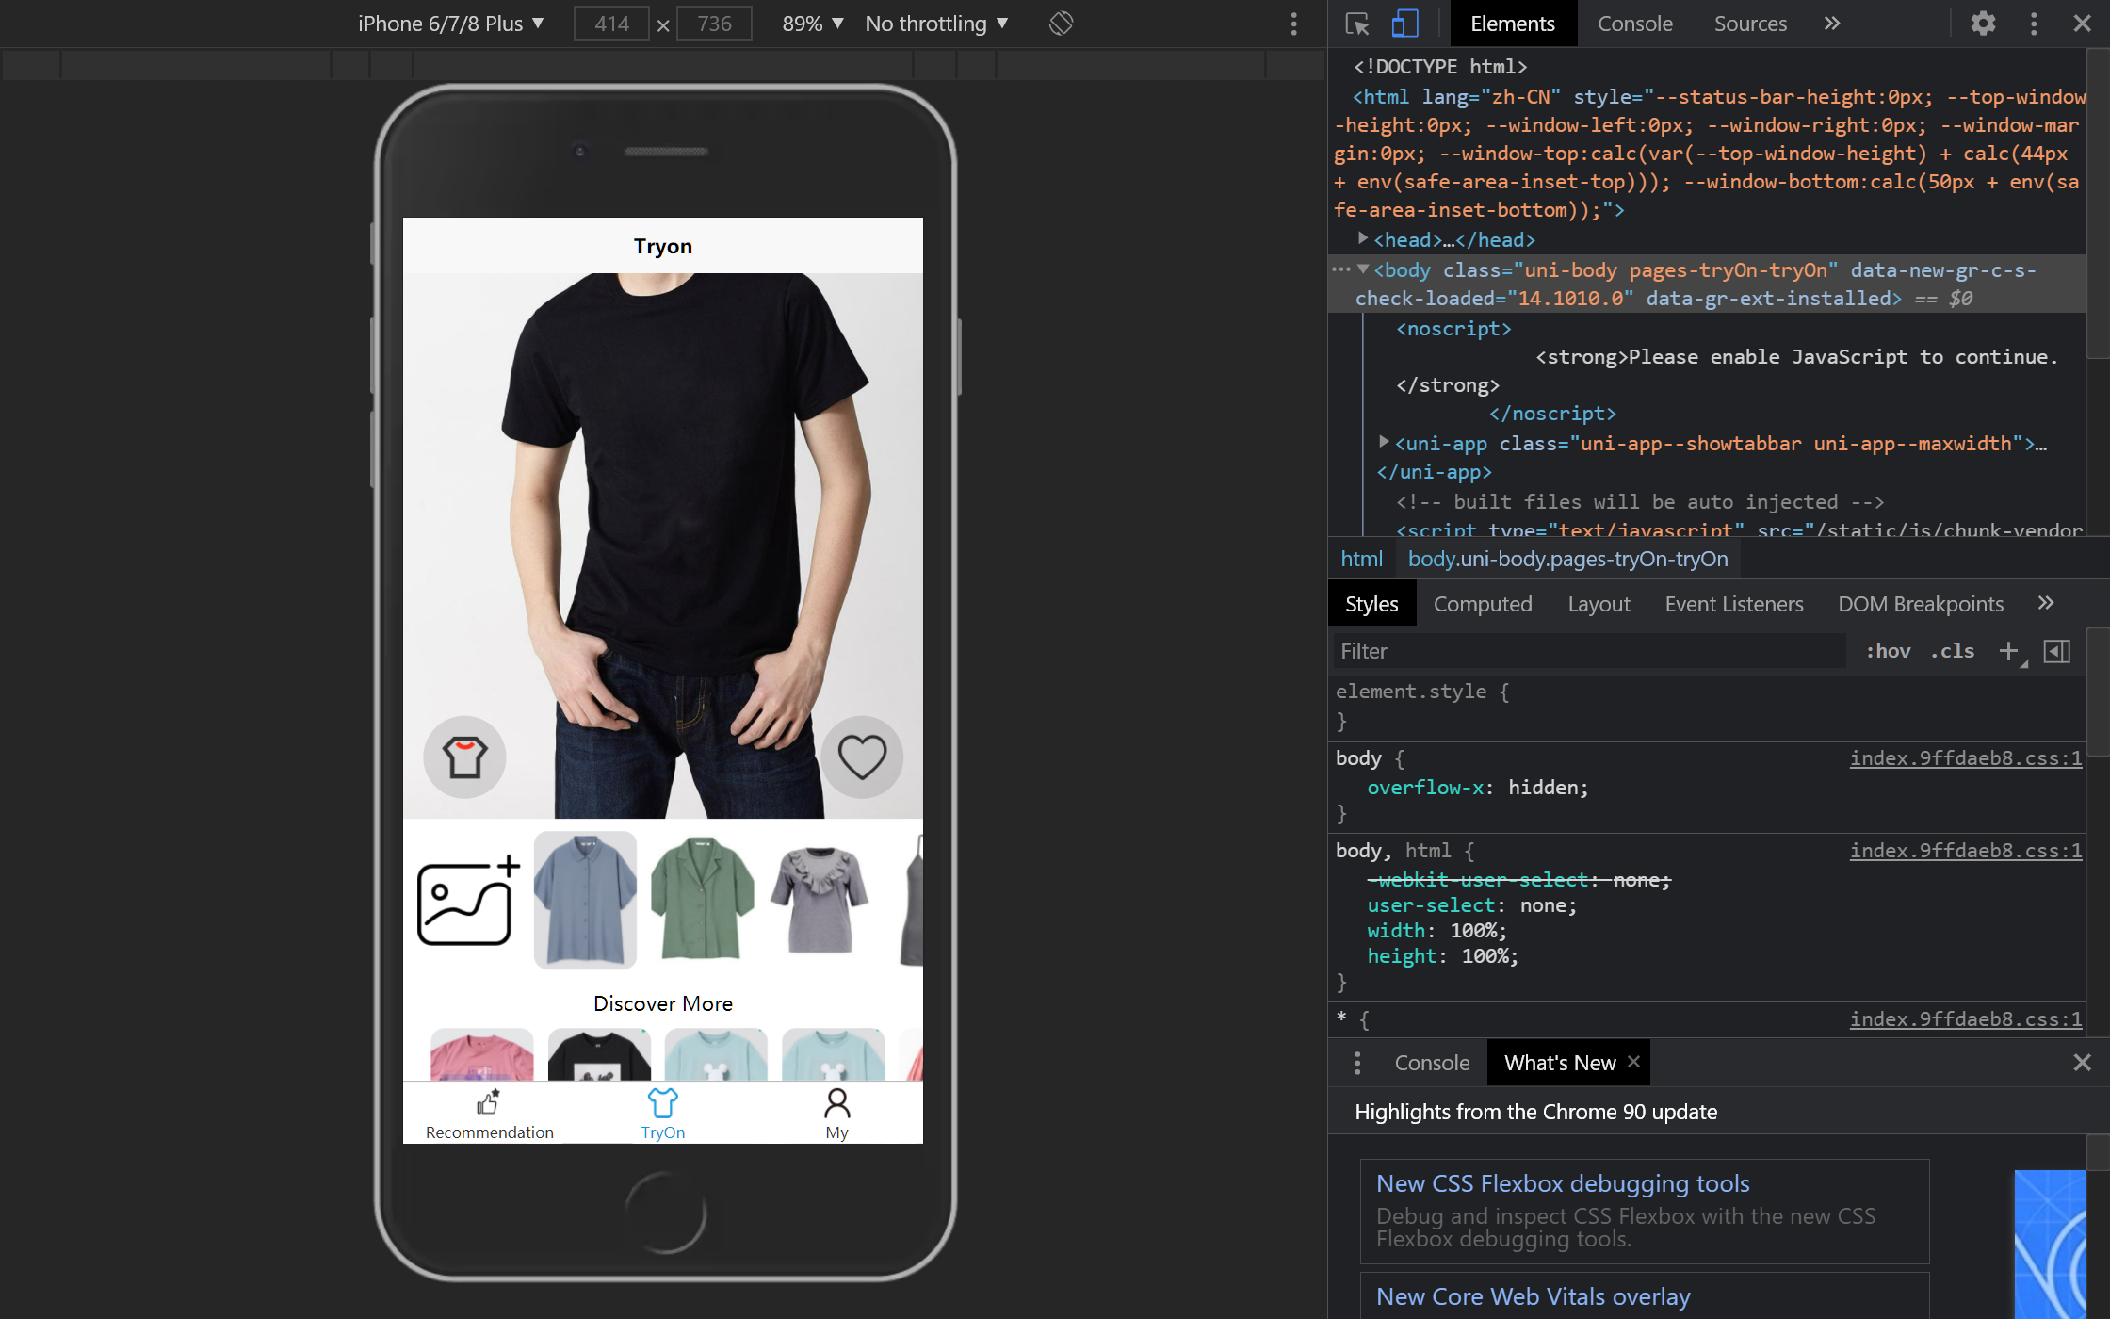
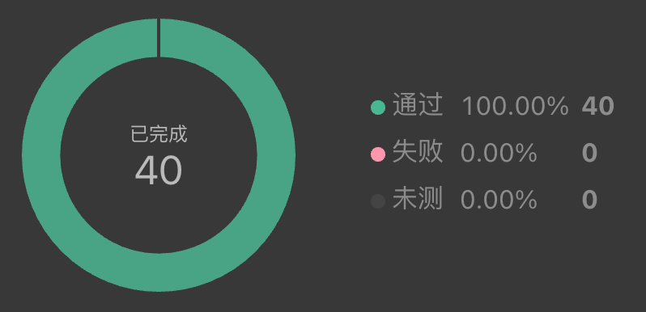
Test Example
Unit Test
Test for every interfaces
Component Test
Mock Test for frontend
REST API Test for backend
Algorithem Demo
Average response time for GET Request
System Test
* APP
Performance Test
Speed test
Stress testing
40 Threads Stress Test

Slide 32
4.3
Algorithm
Implementation

Slide 33


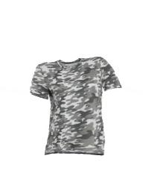

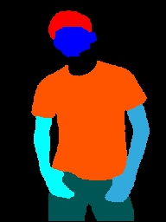
Algorithm Framework
3. Virtual try-on
Transform the cloth and put it on human body
1. Get cloth mask
Let the computer know what the cloth is like
2. Get human mask
Let the computer know where the cloth should be

Slide 34

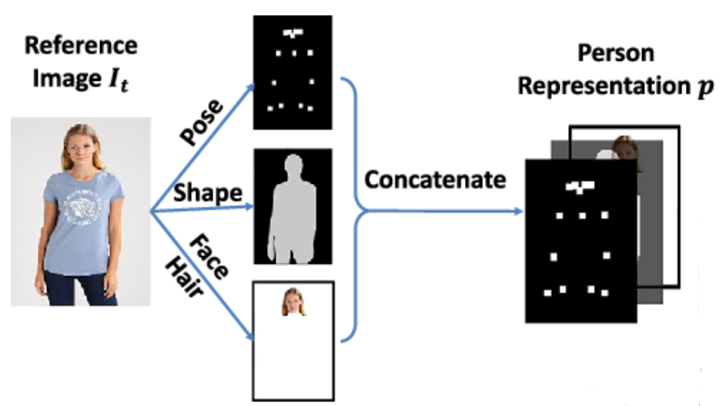
WechatIMG1424.jpeg
What do we do in Algorithm Part?
40% Speed Up
(mainly on model inference)
Fuse three deep learning models into one and refactor algorithm codes
Retrain the model with self-collected Chinese image
Notes:
Refactor = Remove unnecessary processing + Rewrite the API

Slide 35
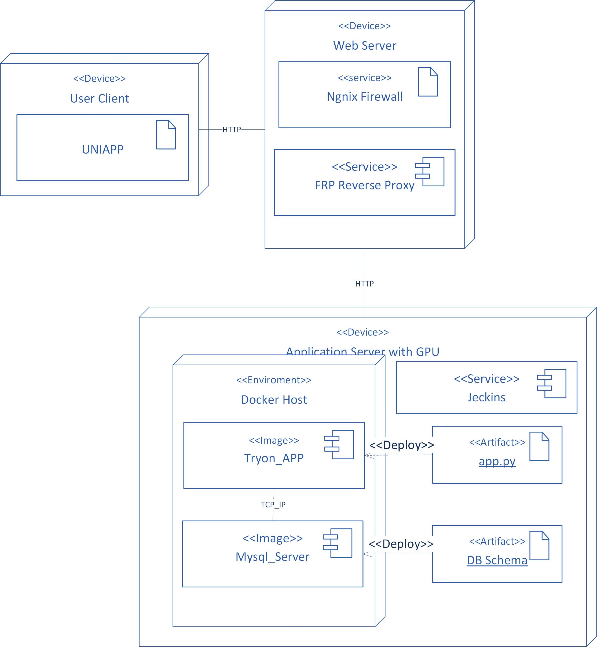
Server Organization
Web server
Baota Firewall to prevent SQL injection and Challenge Collapsar
FRP Software for doing reverse proxy to local GPU server
Application Server
NVIDIA Docker to provide virtual GPU environment and secure the bare-metal host server
Jeckins to perfrom CI/CD
25%

Slide 36
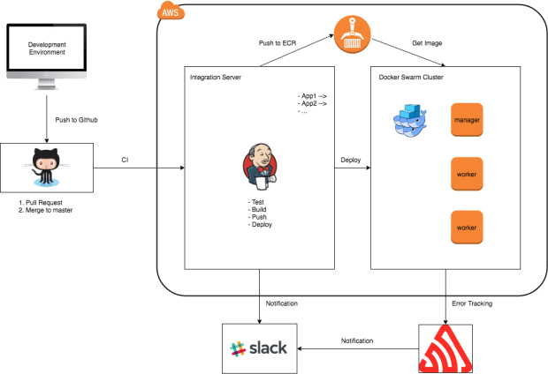

Continuous Integration(CI) and Continuous Delivery(CD)
1. Automatic unit test
branch merge
pull to server
automatic unit tests
Server
Jenkins Service
Docker Service
2. Automatic deployment
Deployed on docker automatically
Restart docker worker
3. Automatic reminder
Generate deployment report
Sending result email

Slide 37
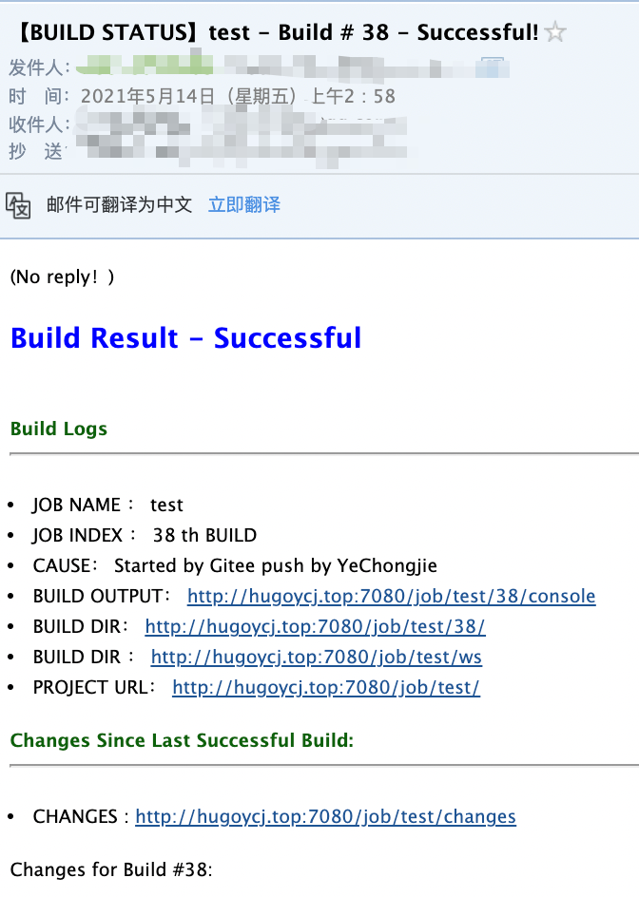
Automatic Reminder through email
Fib1. Subject of the deployment reminder
Fib2. Example of CI/CD result

Slide 38
4.4
Database

Slide 39
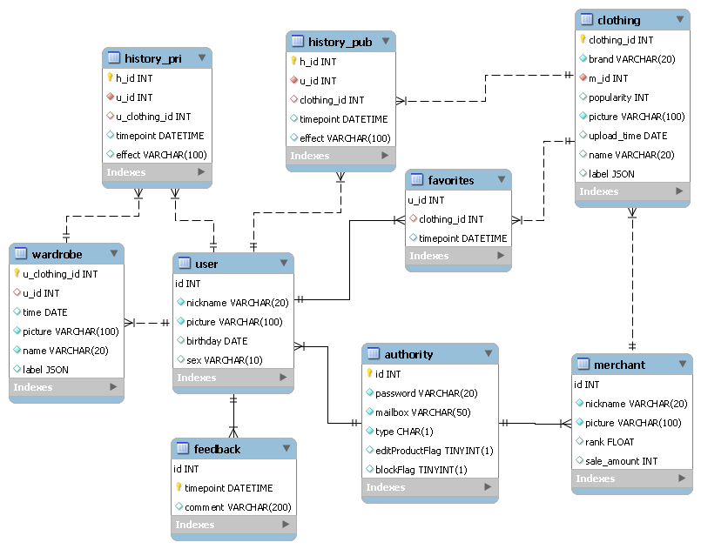
Database
Stored in Cloud Server
Separate user info
and merchant info
3NF

Slide 40


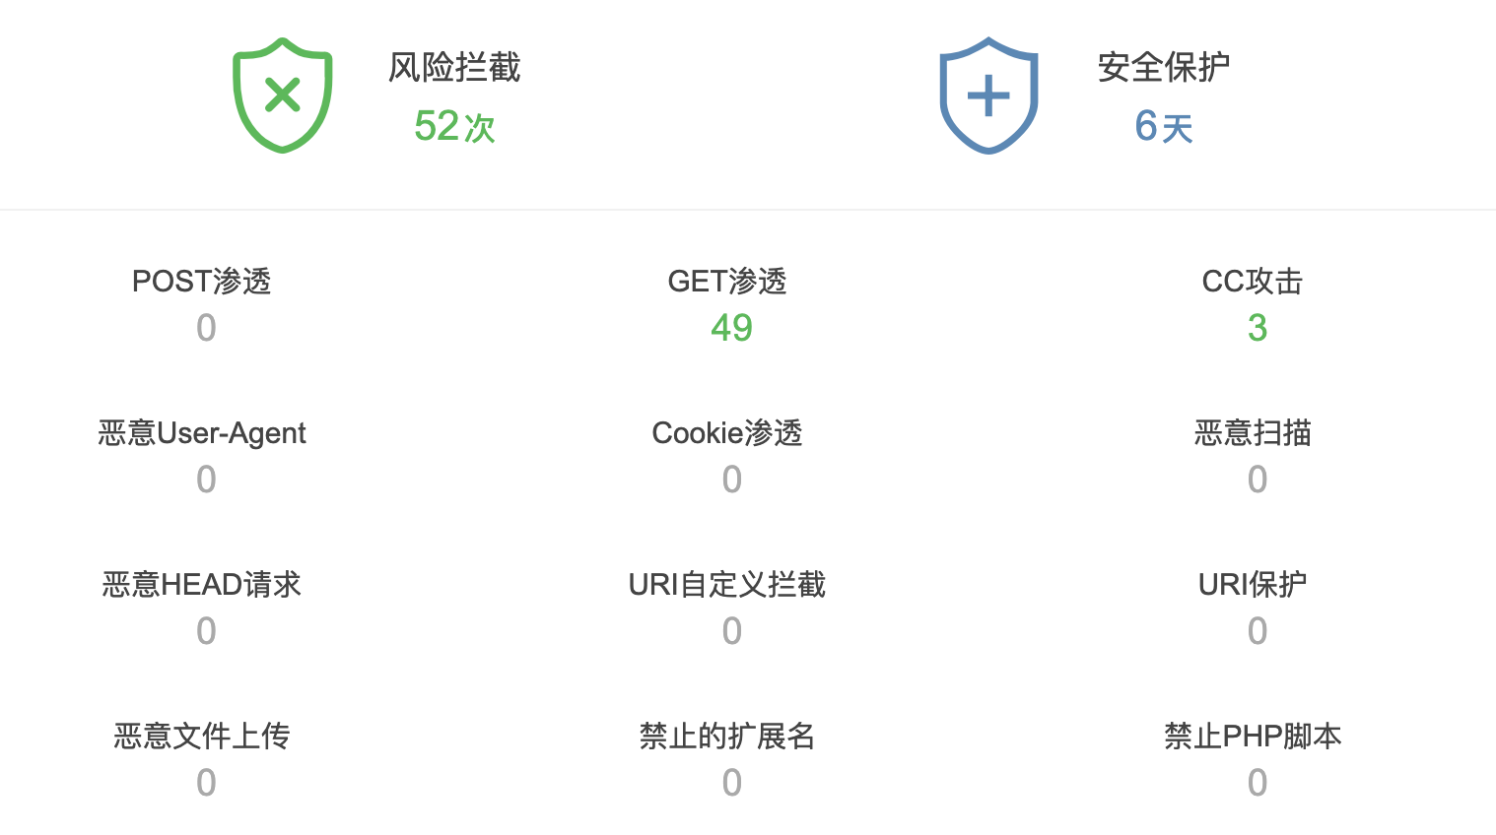
Server Security
Firewall
Baota Company
Scan, head off and block the ids with abnormal frequency requests
Prevent challenge collapsar, SQL injection, computer virus scan

Slide 41
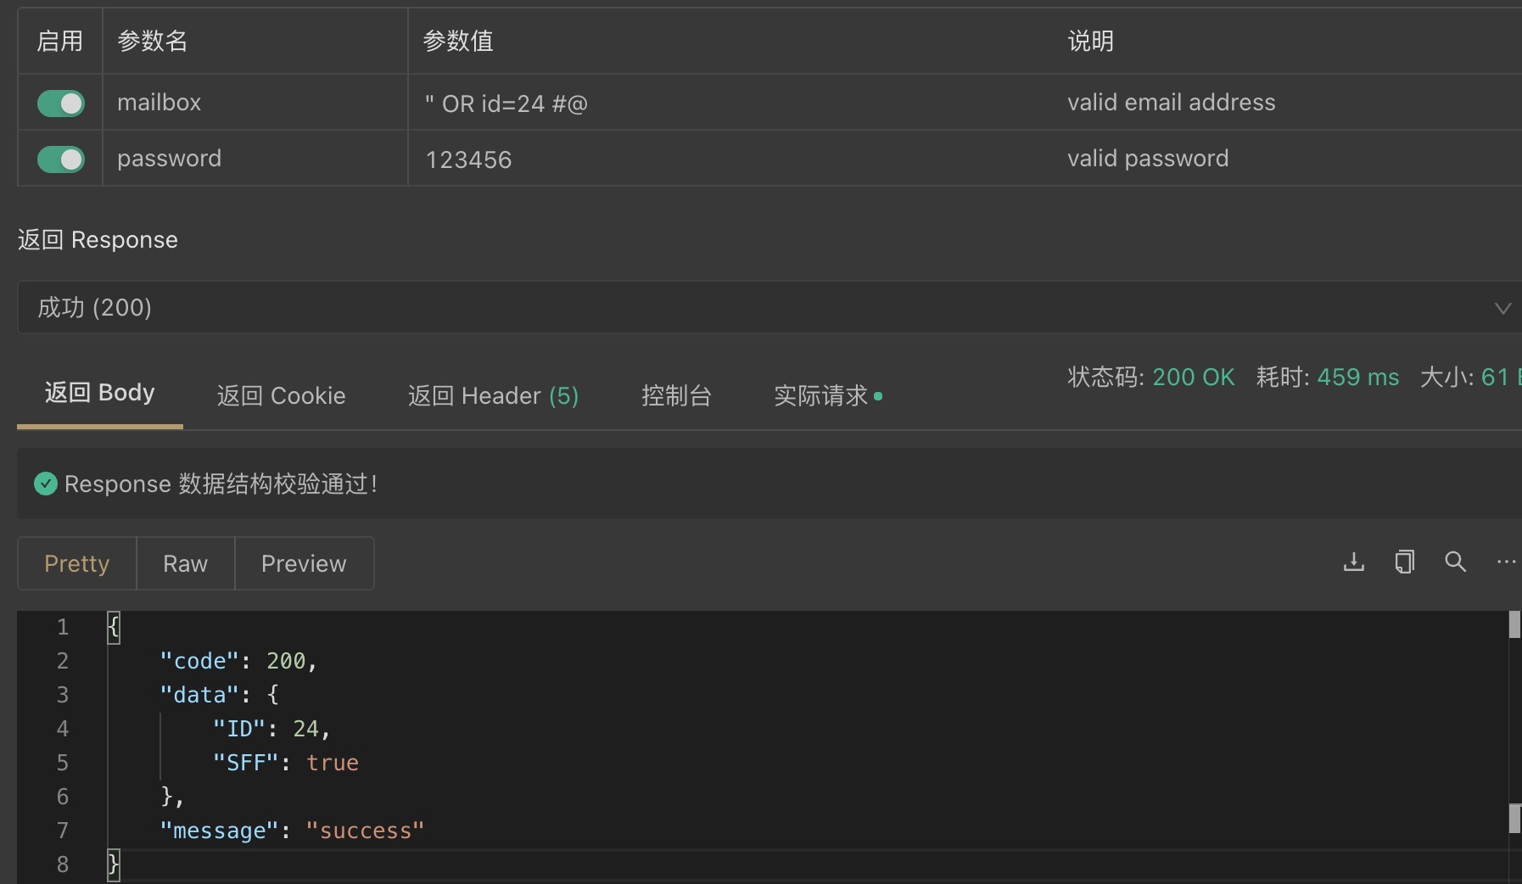
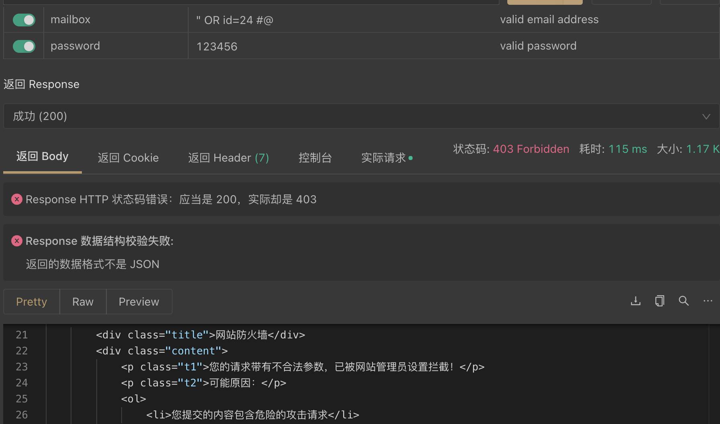
Server Security
SQL injection without firewall – PASS
SQL injection without firewall – FAIL

Slide 42

5
Conclusion

Slide 43







Conclusion
Huge project
Superiority
State-of-the-art algorithm
Customized
Economically friendly
Low threshold
Promising
Commercially valuable

